Slide 1
MFC - Play Sound

Slide 2
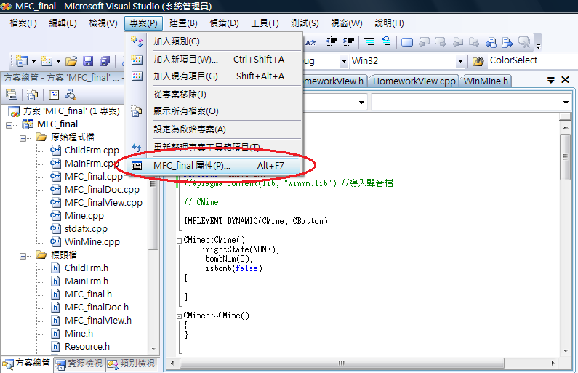
Method One – Project Setting(1/3)

Slide 3
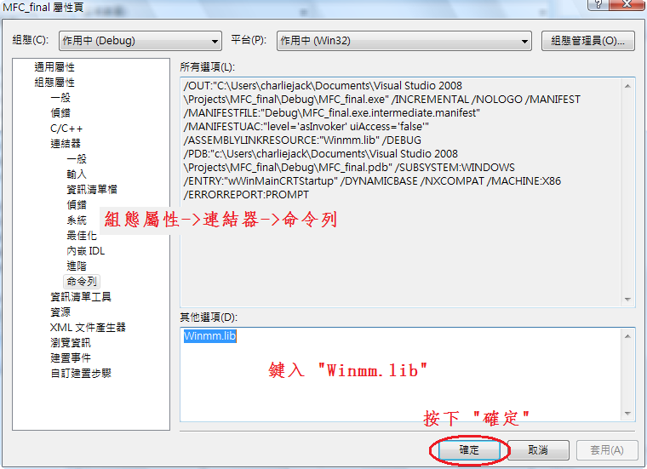
Method One – Project Setting(2/3)

Slide 4
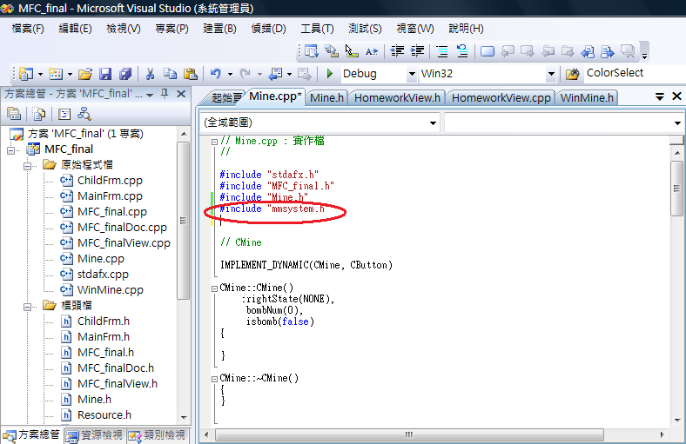
Method One – Project Setting(3/3)

Slide 5
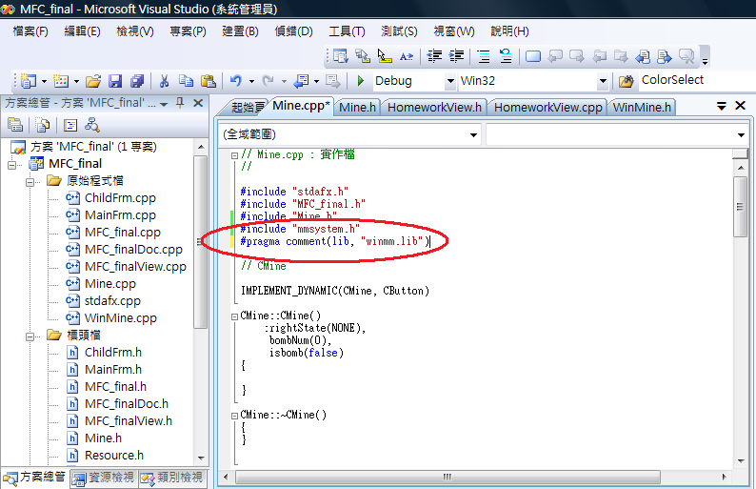
Method Two – Setting in the Program

Slide 6
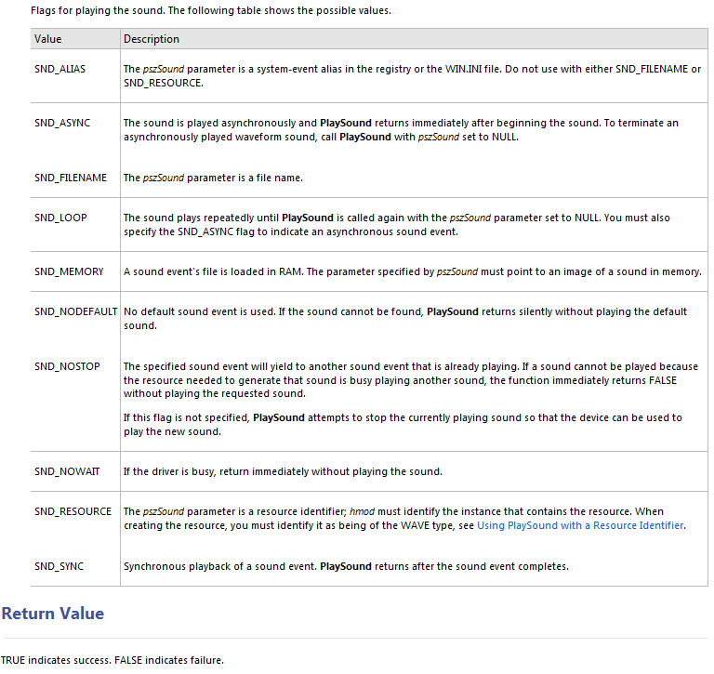

Slide 7
SND_ASYNC – 非同步播放
SND_SYNC – 同步播放
SND_LOOP – 循環播放
SND_NOSTOP – 一定會完整播放一個檔案
SND_FILENAME – 第一個參數是聲音檔的Path
SND_RESOURCE – 由”資源符號”呼叫在專案中的聲音檔

Slide 8
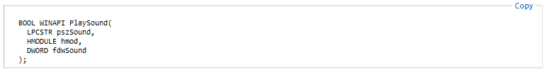
PlaySound(_T(".//res//bomb.wav"), NULL, SND_FILENAME | SND_NODEFAULT | SND_ASYNC | SND_NOSTOP);
PlaySound(MAKEINTRESOURCE(IDA_BOMB), AfxGetResourceHandle(), SND_RESOURCE | SND_NODEFAULT | SND_ASYNC | SND_NOSTOP);

Slide 9
Demo

